Slide 1

Functions
HK Rana

Slide 2

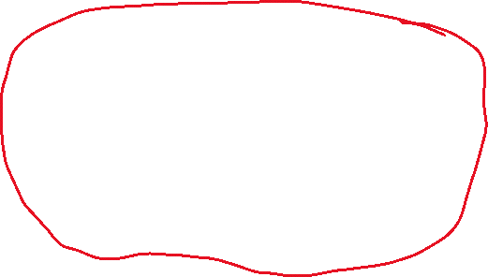
















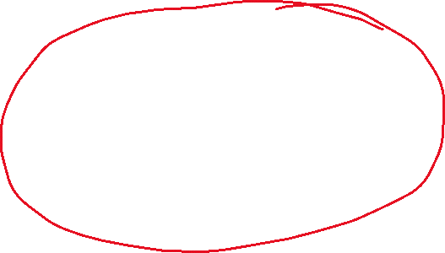








Slide 3
Why Functions?
In c, we can divide a large program into the basic building blocks, known as function.
In other words, we can say that the collection of functions creates a program.
The function is also known as procedure or subroutine in other programming languages.
Advantage of functions in C
By using functions, we can avoid rewriting same logic/code again and again in a program.
We can call C functions any number of times in a program and from any place in a program.
We can track a large C program easily when it is divided into multiple functions.
Reusability is the main achievement of C functions.
Limitation
However, Function calling is always an overhead in a C program.

Slide 4
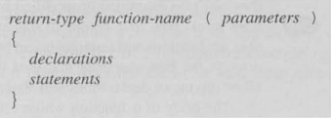
Function Definitions

Slide 5

Arguments
Passed by values
Demonstrate the example of Factorial

Slide 6

Function Calls

Slide 7
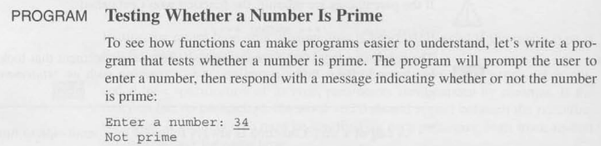

Slide 8
Function Declaration
Before
After

Slide 9

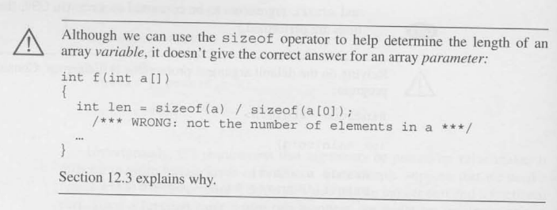
Array Arguments

Slide 10
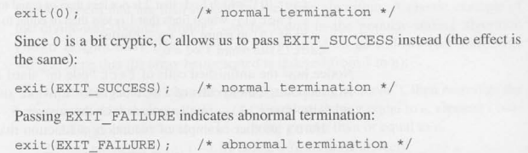
The Return & Others
The Return Statement
Program Termination
The Exit Function

